Slide 1

C
LIBRARY BOOK MANAGEMENT SYSTEM
Using Binary Search Trees (BST)
CSE-A
ID | NAME
A25126510398 | S.YAMINI
A25126510399 | S.JAHNAVI

Slide 2

Problem Statement
• Manual management of book records becomes difficult
as the number of books increases.
• Searching for a particular book may require
checking records sequentially.
• Maintaining sorted records manually requires additional effort.
• The proposed system uses a Binary Search Tree
to store and organize books dynamically.
• The system supports insertion, searching, deletion and sorted display.

Slide 3

Introduction
• Library Book Management System is a console-based
C application.
• Each book is represented by a dynamically allocated
BST node.
• Book ID is used as the unique BST key.
• BST comparisons direct the search to the left or right subtree.
• Inorder traversal displays books in ascending order of Book ID.

Slide 4
Objectives
Automate Library Operations
Reduce manual work and saves time
Provides easy and efficient book management
Improve user experience and increase accessibility

Slide 5
Features of the System
📚 Add Book — stores Book ID, title and author.
🔎 Search Book — finds a book using its Book ID.
🗑 Delete Book — removes a book from the BST.
📋 Display All Books — uses inorder traversal for sorted IDs.
📤 Issue Book — changes status from Available to Issued.
📥 Return Book — changes status from Issued to Available.

Slide 6
Technologies Used
Programming Language: C
Data Structure: Binary Search Tree (BST)
DSA Concepts:
• Structures and pointers
• Dynamic memory allocation using malloc()
• Recursion
• Tree traversal
• Searching, insertion and deletion
• String handling and console input

Slide 7
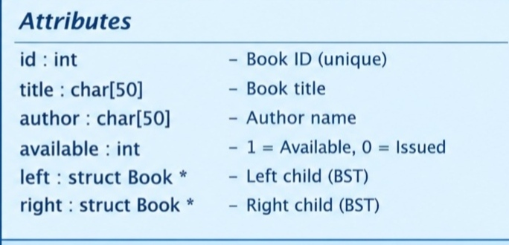
System Design – BST Node Structure
BST rule: left subtree < current ID < right subtree.

Slide 8
Functions Explanation
📖 createBook() – Creates a new book node.
📕 insertBook() – Inserts a book based on Book ID.
🔍 searchBook() – Searches for a Book ID recursively.
📘 findMin() – Finds the smallest Book ID.
🗑️ deleteBook() – Deletes a book from the BST.
📚 displayAll() / inorder() – Displays books in sorted ID order.
🔄 issueBook() / returnBook() – Updates book availability.
💾 freeTree() – Frees all allocated memory.

Slide 9
Working of the System:
START
↓
↓
↓
↓
↓
↓
Display Menu
Add /
Search /
Delete /
Display /
Issue /
Return
Perform
Operation
↓
Update book status
Return to Menu
EXIT

Slide 10
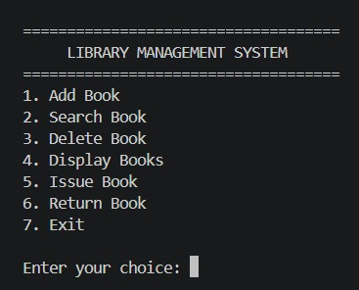
Sample Output
MENU SCREEN

Slide 11
Advantages of the System
⏱ Saves time compared with sequential record checking.
⚡ Efficient average-case search, insertion and deletion.
📋 Inorder traversal automatically gives sorted Book IDs.
🧠 Demonstrates important DSA concepts in a real-world application.
💾 Dynamic allocation allows the number of nodes to grow or shrink.
🖥 Simple console-based interface for academic demonstration.

Slide 12
Future Scope
🔹 Use AVL Tree or Red-Black Tree for guaranteed logarithmic height.
🔹 Add file handling or relational database storage.
🔹 Add student/member records and due dates.
🔹 Add fine calculation and reservation support.
🔹 Add search by title or author.
🔹 Develop a graphical or web-based interface.
🔹 Add authentication and multi-user support.

Slide 13
Conclusion
🌳 The system demonstrates the practical use of a Binary Search Tree (BST).
📖 It supports insert, search, delete, display, issue, and return operations.
💻 It demonstrates structures, pointers, recursion, and dynamic memory
allocation.
⚡ BST operations take O(log n) on average and O(n) in the worst case.
🚀 The system can be extended with file storage, balanced trees, and a GUI.

Slide 14
THANK YOU

